Slide 1
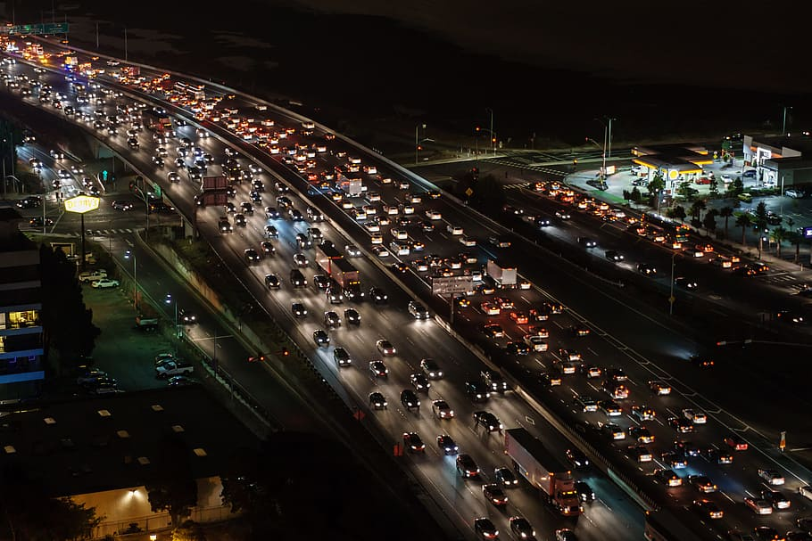
Transport Demand Prediction
Traffic Jam: Predicting People's Movement into Nairobi
Name Of The Participants
Pratibha Sanganmath Priyanka Gorkhe Rahul Deshmukh Prince Priyadarshi

Slide 2
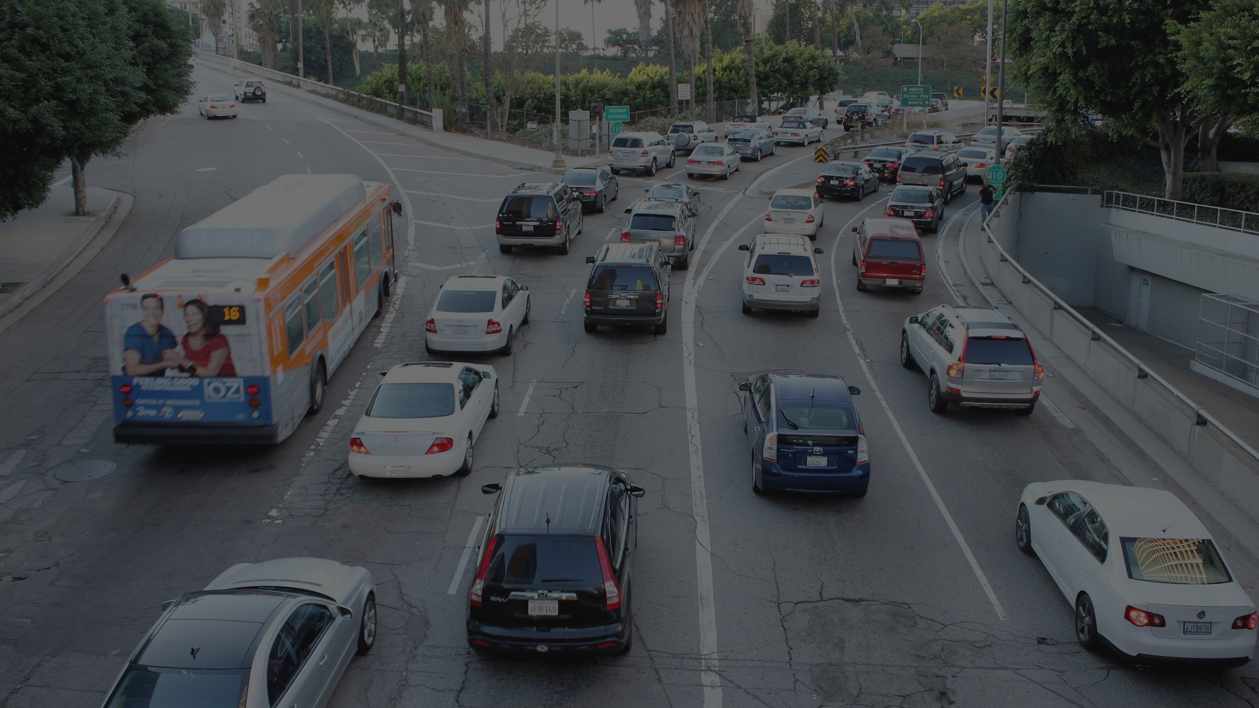
Points To Discussed:
-Data Summary
-Data Cleaning
-Defining problem statement
-EDA
-Feature Selection
-Preparing dataset for modeling
-Applying Model
-Model validation and selection
-Conclusion

Slide 3

Data Summary/Data Cleaning
Data processing-In this first part we’ve removed unnecessary features.
Shape of data
Rows-51645, columns-10
Numerical features:
ride_id',
‘max capacity'
Categorical features:
Seat number,
Payment method,
Payment receipt,
travel date,
travel time,
travel from,
Travel to,
Car type,
constant feature:
travel_to: “Nairobi”
Drop_column
droping the unwanted columns or the column containing constant value.
Dataset
Fully cleaned data

Slide 4
Variables description:
Ride id: unique ID of a vehicle on a specific route on a specific day and time.
Seat number: seat assigned to ticket
Payment method: method used by customer to purchase ticket from Mobi ticket (cash or Mpesa)
Payment receipt: unique id number for ticket purchased from Mobi ticket
Travel date: date of ride departure. (MM/DD/YYYY)
Travel time: scheduled departure time of ride. Rides generally depart on time. (hh:mm)
Travel from: town from which ride originated
Travel to: destination of ride. All rides are to Nairobi.
Car type: vehicle type (shuttle or bus)
Max capacity: number of seats on the vehicle

Slide 5
Problem Statement:
Exploring 14 different towns to the North-West of Nairobi towards Lake Victoria and using the data provided by bus ticket sales from Mobi ticket, predicting the number of tickets that will be sold for buses that ends into Nairobi. West of Nairobi towards Lake Victoria and using the data provided by bus ticket sales from Mobi ticket, predicting the number of tickets that will be sold for buses that ends into Nairobi.

Slide 6
Steps involved in supervised ML model:
Defining the problem statement
Pre-processing the data
Splitting the data into train and test data
Training the model
Evaluating the model
Improve the model
Deploy the model and monitor real-time

Slide 7
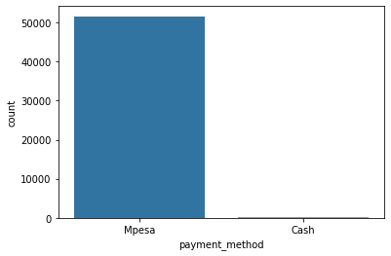
EDA(EXPLORATORY DATA ANALYSIS):
Analysis of different variables:. Analyzing the payment method
There are two type of payment methods people have used to buy the tickets.
Travelers have used 2 types of payment method.
They are Mpesa and cash.
And the most of the people have used Mpesa
to pay for their ticket.

Slide 8
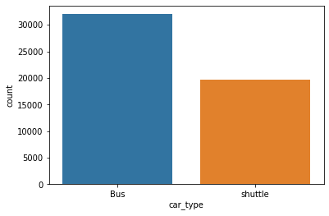
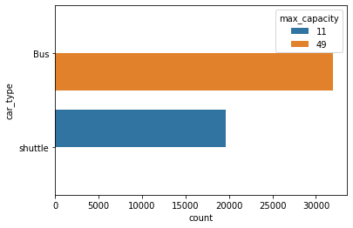
Analyzing the vehicle type used by the customer and number of seats on the vehicle sell
There are 2 different types of car used(shuttle and bus) and most of them are bus.
There are two type of cars Bus and shuttle and the maximum capacity of the bus is 49 while shuttle can contain 11 travelers.

Slide 9
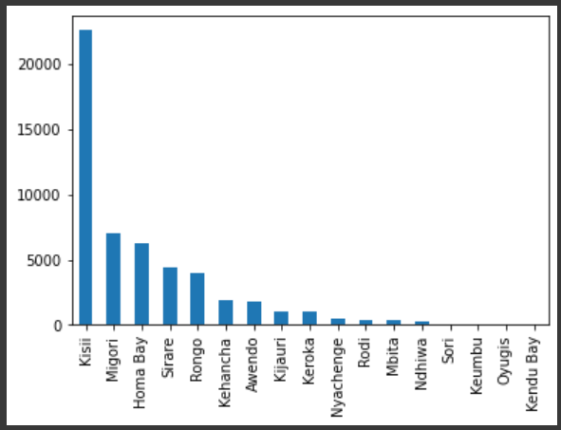
Analyzing the travel from town from which ride originated
Most customers travel from Kisii town to Nairobi.

Slide 10
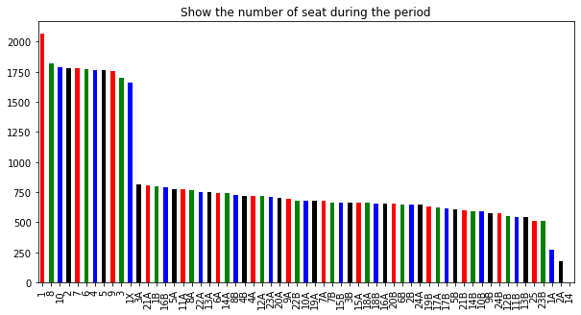
Analyzing the number of seat during the period using bar graph
There are totally 61 unique seats in this dataset. The record of 149 unique days are present in this dataset out of 2 years.

Slide 11
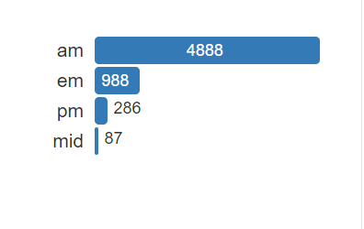
Analyzing the number of persons travelling in which time zone
The most of the people used to travel in
the morning time compared to other times.
Here we can see that 4888 customers
were travelled in the morning.

Slide 12
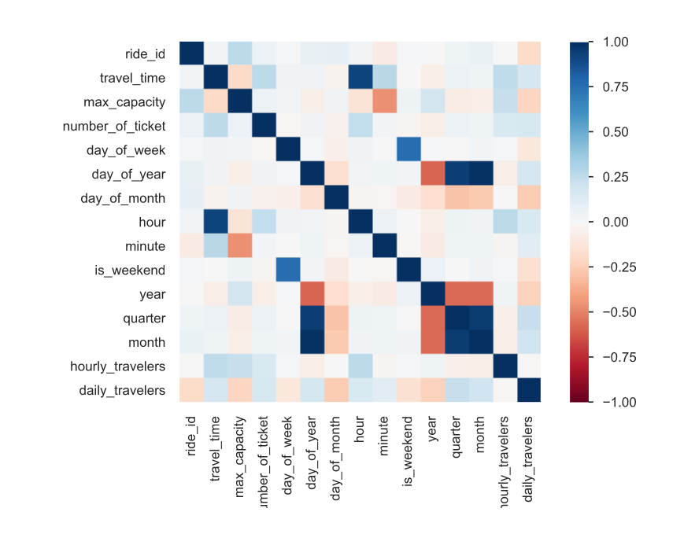
Correlation
Correlation coefficients quantify the association between variables or features of a dataset.
This heatmap of correlation between
different independent variables.
The matrix shows the coefficients
in the squared form colored as per
the intensity scale. The map has
positive covariance as with the
increase in one variable another
also increasing.

Slide 13
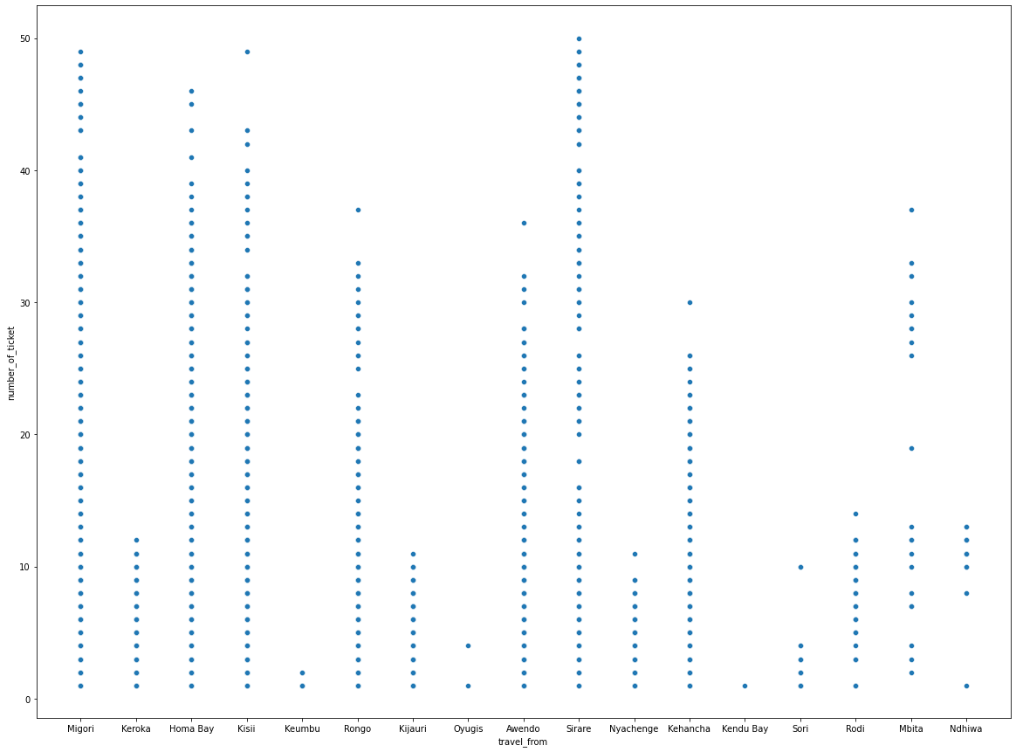
Scatter plot of number of tickets sold to customers from different cities

Slide 14
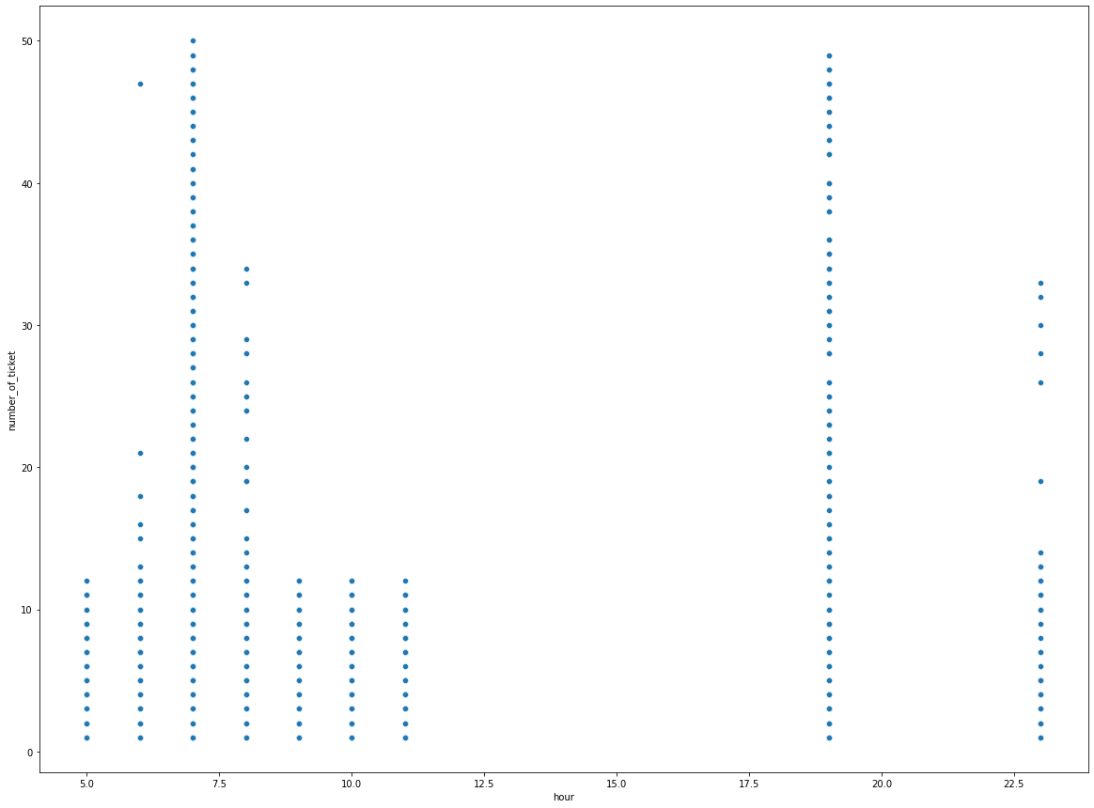
Feature Engineering
We can see that most of the tickets
were sold at 7 AM and 8 PM.
And that seems true because in the
morning most of the people go to the
work and office.
From the above we can say that there
is not ride between 12pm to 5.30Pm

Slide 15
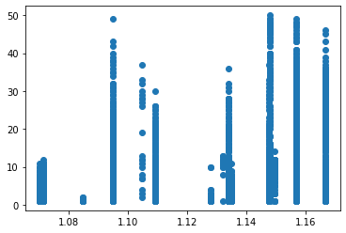
The following figure shows the scatter plot of number of tickets sold to customers verses the speed(the speed here is the time travelled by customers from different distances)

Slide 16
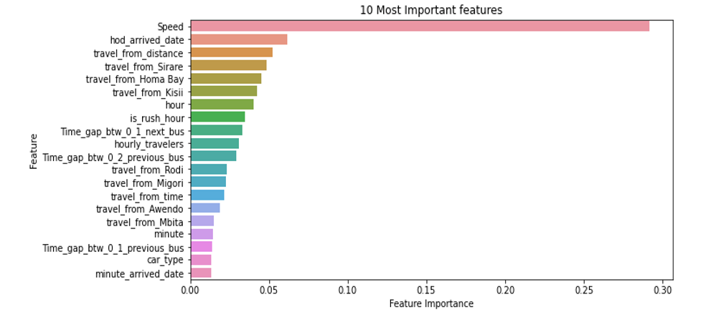
Futuristic Features

Slide 17
Training the model
Fitting different models
For modeling we tried various classification algorithms like:
➤ Linear Regression
➤Regularized linear regression (Ridge and Lasso)
➤GBM
➤ Random Forest Regressor
➤XGboost regressor

Slide 18
Evaluating the model
After the model is built, if we see that the difference in the values of the predicted and actual data is not much, it is considered to be a good model and can be used to make future predictions.
Few metric tools we can use to calculate error in the model
1.MSE (Mean Squared Error)
2.RMSE (Root Mean Squared Error)
3.MAE (Mean Absolute Error)
4.MAPE (Mean Absolute Percentage Error)
5.R2(R – Squared)
6.Adjusted R2

Slide 19
ML Models and Metrics
TYPE OF REGRESSION | Train Score | Test Score | R2 SCORE | ADJ_R2 | MAE | MSE
LINEAR | 0.4176 | 0.3591 | 0.3546 | 0.3437 | 4.7850 | 49.1402
GRADIENT BOOSTING | 0.6877 | 0.6129 | 0.6877 | 0.6043 | 3.5350 | 29.0469
RANDOM FOREST | 0.6028 | 0.5919 | 0.5919 | 0.5830 | 3.5291 | 30.6252
XGBOOST | 0.8455 | 0.8421 | 0.84211 | 0.8386 | 2.2667 | 11.8493

Slide 20
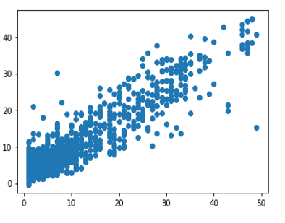
Scatter plot of test and predicted values
XGboost regressor:
We used different types of regression algorithms
to train our model like Linear Regression,
Regularized linear regression (Ridge and Lasso),
GBM, Random Forest Regressor, XGboost regressor.
And also we tuned the parameters of Random forest
regressor and XGboost regressor and also found the
important features for training the model . Out of them
XGboost with tuned hyperparameters gave the best
result.
XGBoost expects to have the base learners which are uniformly bad at the remainder so that when all the predictions are combined, bad predictions cancels out and better one sums up to form final good predictions.

Slide 21
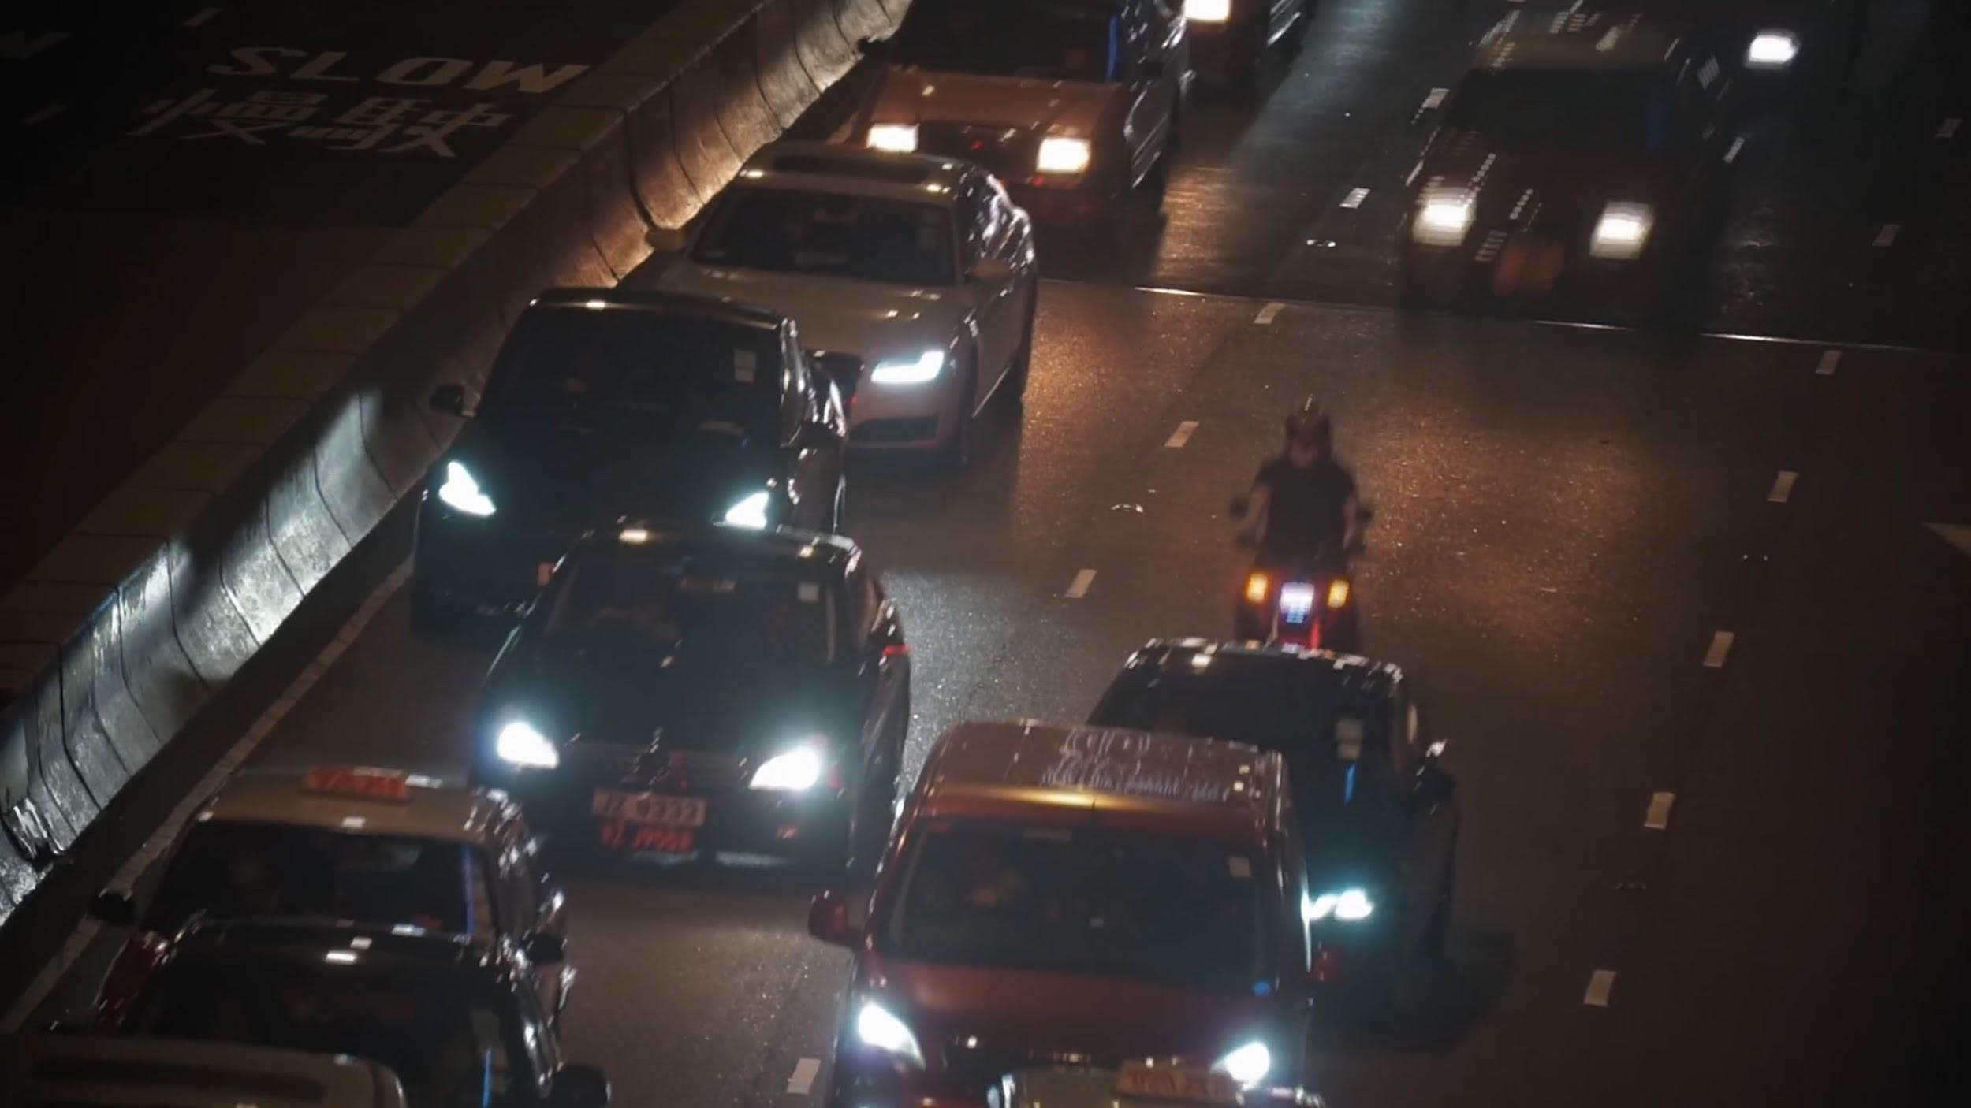
Conclusion
Starting with loading the data so far we have done EDA , null values treatment, encoding of categorical columns, feature selection and then model building.
We used different types of regression algorithms to train our model like Linear Regression, Regularized linear regression (Ridge and Lasso), GBM, Random Forest Regressor, XGboost regressor. And also we tuned the parameters of Random forest regressor and XGboost regressor and also found the important features for training the model. Out of them XGboost with tuned hyperparameters gave the best result.
So the accuracy of our best model is 84% which can be said to be good for this large dataset. . This performance could be due to various reasons like no proper pattern of data, too much data,and not enough relevant features.

Slide 22



